Slide 1

U-Commerce and Data Management
The only way to predict the future is to have the power to shape the future.
Eric Hoffer, The Passionate State of Mind, 1954

Slide 2
Types of Commerce
Type | Foundation
Commerce | Transportation network
E-commerce | Internet
M-commerce | Cell phone network
U-commerce | Ubiquitous networks

Slide 3
U-Commerce
The use of ubiquitous networks to support personalized and uninterrupted communications and transactions between a firm and its various stakeholders to provide a level of value over, above, and beyond traditional commerce

Slide 4
Elements
Ubiquitous
Universal
Unique
Unison

Slide 5


Ubiquitous
Networks everywhere
All consumer durable devices are on a network
Intelligence and information are widely dispersed and always accessible
Smart entities
  Appliances
  Buildings
  Signs
Street smart communities

Slide 6
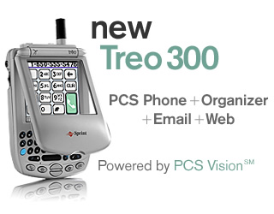
Universal
Multifunction information appliances
Devices work everywhere
  All networks
  All locations
  Always connected
Universal access

Slide 7


Unique
Information is customized
  To person
  To device
  To context
    Location
    Time
    Role

Slide 8
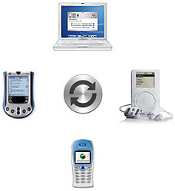
Unison
Synchronization/replication of designated files
Transparent to owner
Current data are always available
Team work synchronization

Slide 9
U-space

Slide 10
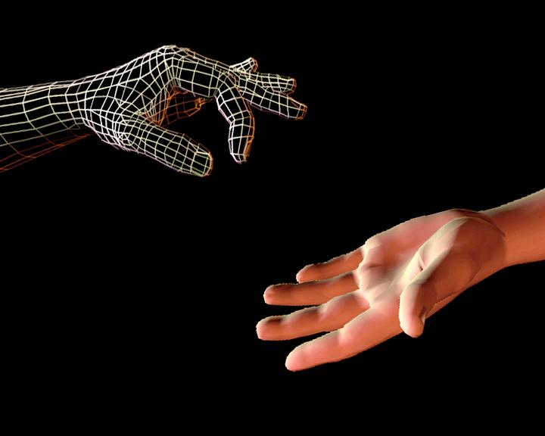
Hyper-real
Ultra-conscious & unique
Extraordinary experience
  Adventuring
  Entertainment
  Teleimmersion
Immersion marketing
  Processes that enhance conscious interaction with the phenomenal world in specific situations

Slide 11
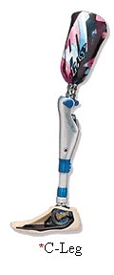
Post-human
Ultra-conscious & ubiquitous
The network is always on
Permanent enhancement of human facilities
  Information processing
    Cell phone/PDA
  Advanced prosthetics
  Genetic enhancement
Body change
  Rhinoplasty
Transformation marketing
  Processes that enhance conscious interaction with the phenomenal world acontextually – that is transcending specific time-space locations

Slide 12

Matrix
Unconscious & ubiquitous
Move tasks from conscious to unconscious
Automated consumption
  Automated toll booths
  Smart cards
Automatic background execution
  Price comparison bots
Attention freeing
Matrix marketing
  Universal, acontextual processes designed to automatically perform tasks

Slide 13
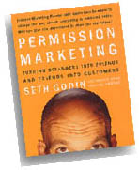
Node
Unconscious & unique
Subscription services
CRM tries to understand the customer so well that offers easily capture attention
Ultimate form of permission marketing
  Wine-of-the-month club
Nodal marketing
  Processes that reduce the necessity of an individual or collective to consciously interact with phenomena in specific contexts

Slide 14
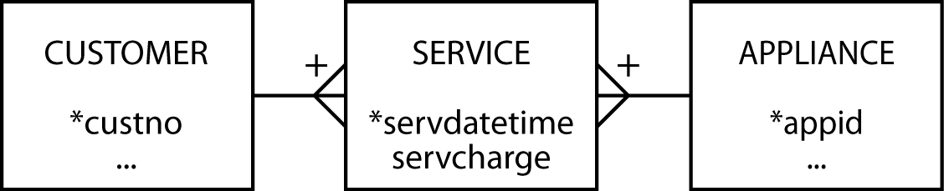
Generic data model

Slide 15
Implications
Humans are five channel information processors
The combination and interaction of these five senses determines the perceived quality of a product or service
Organizations deliver information that creates perceptions

Slide 16
Implications
Digitization started in the mid 1800s
We are the midst of the digitizing revolution
Digital touch, taste, and smell are not yet common

Slide 17
Implications
U-Commerce will increase the importance of data management
More data to manage
More relationships to maintain
More data to deliver exactly when, where, and how customers want it

Slide 18
Conclusion
Major innovations in information processing have profound impacts on most aspects of society
U-Commerce is the ultimate form of commerce

